Slide 1

Brazilian Market Expansion: Partnering with Magist?

Slide 2
Four Pillars of Analysis
1
2
Magist’s growth
Overall strategic alignment
3
4
Delivery times
Customer Satisfaction

Slide 3
Magist's Data: A Comprehensive Overview
Range: 25 months of sales
Includes data for all product categories
Findings are filtered to only “tech accessories”
We have no insight on specific product names / types

Slide 4
Brazilian Market: Overview and Relevant Insights
Market overview
The compound annual growth rate of the market in the period 2014–19 is predicted to be 8.3%. (3.7% in Spain)
12% of users are iOs users - market size: 25 million people
Relevant market insights
Taxes on electronic among the highest 20 in the world
[...] “purchased from the same manufacturers. Players therefore compete on service and price, and only very rarely on product.”
“Brazil applies a 60 % flat import tax”

Slide 5
MAGIST’S GROWTH

Slide 6
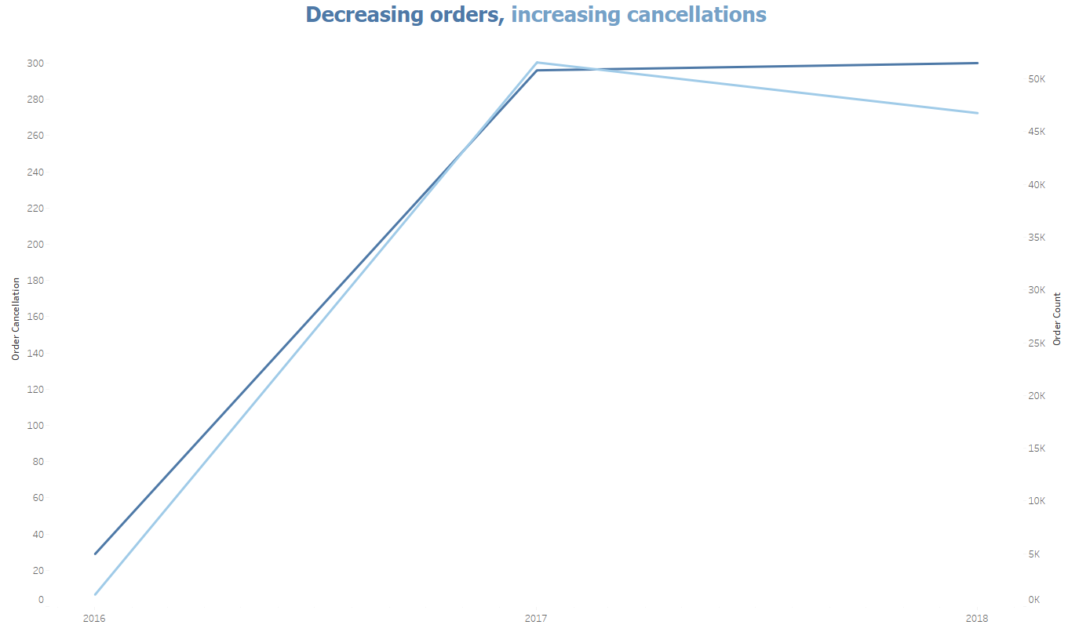
Growth
1

Slide 7
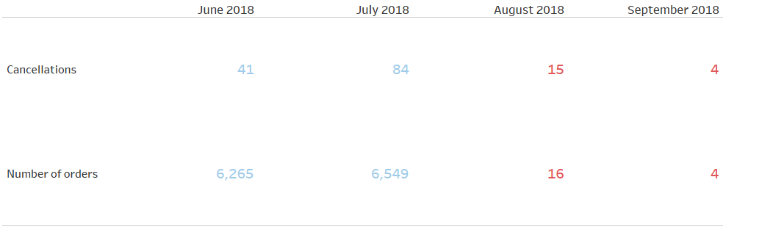
Growth
1
An Unexpected Shift in Magist’s Performance - June 2018
All orders are now cancelled
16.5% of all cancellations happened in the last 4 months

Slide 8
STRATEGIC ALIGNMENT

Slide 9



Alignment
2
5% of products offered are in the tech category
9% of all sellers are tech sellers
Average monthly income of tech sellers is 34.4K
VS.
VS.
VS.
Only 1.7% of all orders included relevant tech items
Only 7% of income goes to tech sellers
Our average monthly income is 1.17M
Low Demand For Tech Accessories Among Magist’s Clients
Notes:
Alignment - sellers / sales

Slide 10
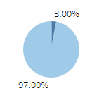
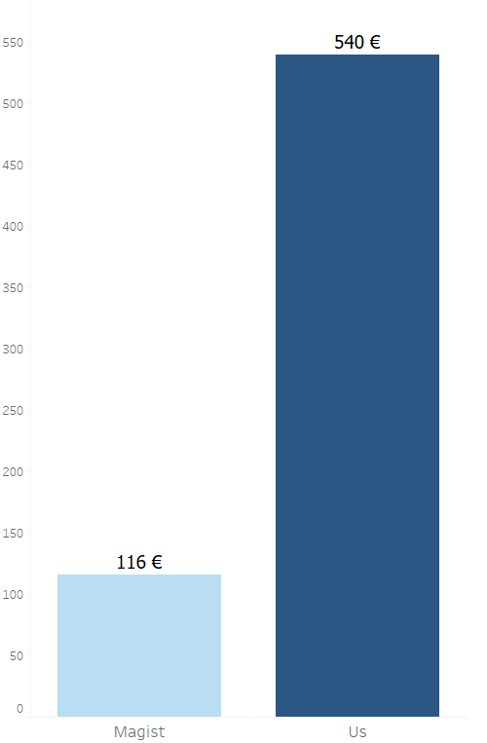
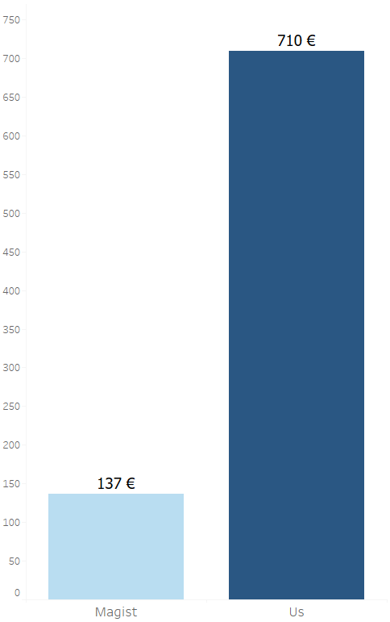
Alignment
2
Average product value
3.8%
Average item value
96.2%
Products valued at or above 300€ only represent 3.8% of the overall tech sales
Understanding Magist's Clientele: A Preference for Affordable Solutions

Slide 11
DELIVERIES

Slide 12
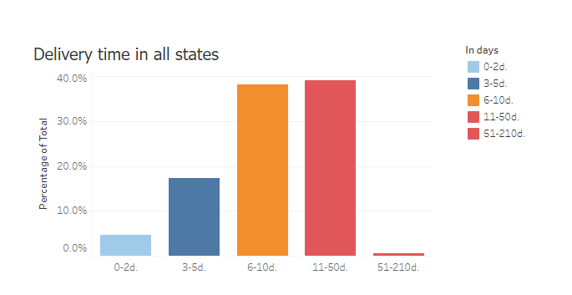
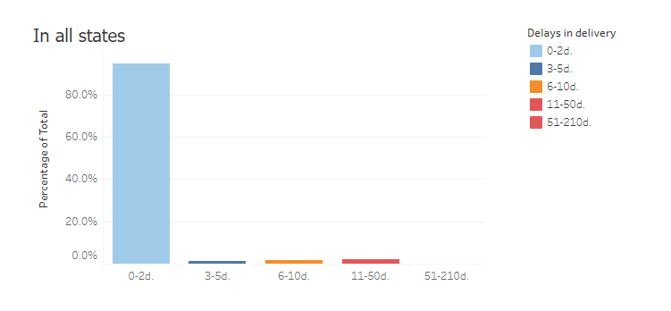
Delivery: Beyond Time - Accuracy vs. Timeliness
Delivery
3
Estimated delivery – actual delivery
Actual delivery times
Estimated delivery is roughly the same as actual delivery given that 94.6% of deliveries are within two days of the estimated ones.

Slide 13
CUSTOMER SATISFACTION

Slide 14
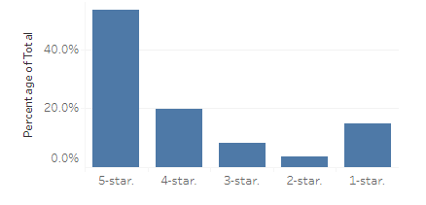
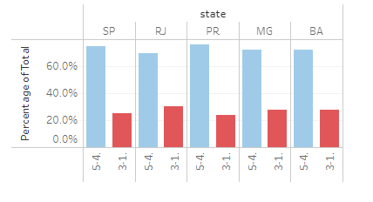
Customer Satisfaction: Positive-Negative Ratio
Satisfaction
4
Customer reviews for all states
Positive and negative reviews* in percentages
Over half of the negative issues mentioned at least one of the following problems:
Post Office loses / steals items
Did not receive everything ordered
Late or never arrived
*
We defined “negative reviews” as anything below 4.

Slide 15



RECOMMENDATIONS
1
2
Brazilian
market
Deliveries
3
Strategic
alignment
4
Customer
Satisfaction
5
Growth

